Slide 1

Enterprise java Beans - 3.0 of Java EE 5
Srinivas Raju - 2006
EJB 3.0 of Java EE

Slide 2
About Me
Working in University of Phoenix as a java developer
Actively participates in Javaranch WebServices and Architect
forums.
Working in java past 8 years. I am a
  Sun Certified Enterprise Architect (I, II and III)
  Sun Certified Web Services Developer
  Sun Certified Business Component (EJB) Developer
  Sun Certified java Developer (I and II)
  Sun Certified java programmer and Web component developer
  Bea Certified Weblogic 7.0 Developer

Slide 3
What about you ?

Slide 4
Agenda
Introduction
Why do we need EJB’s ??
Classification of EJB’s
Difference between EJB 2.0 and EJB 3.0
Java 1.5 Annotations
EJB 3.0 new features
EJB 3.0 benefits
JPA – Java Persistence API Implementation
JBOSS – Trailblazer for EJB 3.0 development
Spring and Hibernate integration with EJB 3.0
Implementation - examples - EJB 3.0 on JBOSS 4.0.4

Slide 5
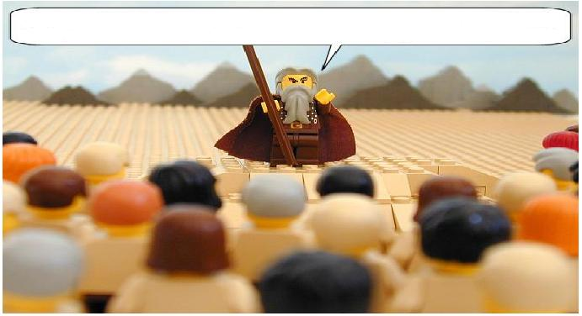
Introduction EJB 3.0

Slide 6
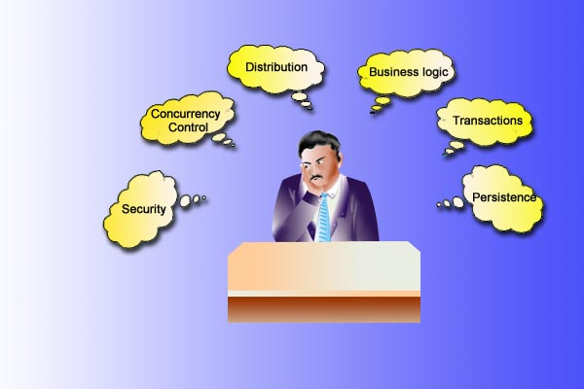
Worries of a Software Engineer - History
Has to Code for
  Business logic
  Transactions
  Security
  Concurrency Control
  Persistence
  Distribution
Life cycle Management
  When to create a component
  When to remove
  Bean Pooling
  Object Caching etc.

Slide 7
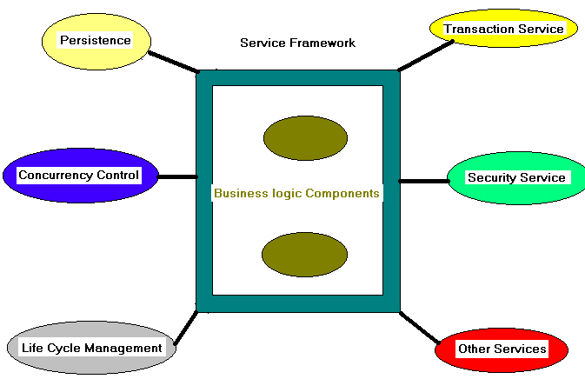
Service Framework – Container Features
Existence of a Service Framework that provides the required services transparently to the component
The Developer needs to focus only on the business logic.
Need not code for the services
  Have to code to access the services
Lower Development time

Slide 8



Why do we need EJB’s ??
Gartner Report on Application Servers and EJB’s
Container
Re-usability

Slide 9

Why do we need EJB’s ??
Fail-Over
Results Caching
Concurrency
Object Pooling
Session Management
Load Balancing

Slide 10


EJB 2.x vs. EJB 3.0

Slide 11
Classification of EJB’s – EJB 3.0
Enterprise Bean
Session Bean
Message Driven Bean
Entity Bean
Stateless
Statefull
BMP
CMP
@Stateless, @Stateful, @MessageDriven @Entity

Slide 12
EJB 3.0 vs. EJB 2.0
EJB 3.0
EJB 2.0

Slide 13
Architecture - EJB 3.0 vs. EJB 2.0
Server
EJB Container
Server
EJB Container
Home
Interface
EJB
Bean
Java
Class
Java
interface
Remote
Interface
Client
EJB 3.0
EJB 2.0

Slide 14
EJB 3.0 vs. EJB 2.0
Home Interface
Remote/Component Interface
Bean Class – with life cycle methods
ejb-jar.xml
weblogic-ejb-jar.xml
Client class
Java interface
Java class
Client class

Slide 15
EJB 3.0 vs. EJB 2.0
Powerful, but more complex
Complex programming model
  Home interface - EJBHome/EJBLocalHome
  Component interface - EJBObject/EJBLocalObject
  EnterpriseBean interfaces
  mandatory ejbXXX methods in bean class
  JNDI for environment access
  mandatory ejb-jar.xml deployment descriptor
  vendor-specific descriptor for binding JNDI name
  Awkward programming model
Lots of boilerplate codes for bean and its client
EJB 2.0

Slide 16
EJB 3.0 vs. EJB 2.0
Ease of Development
  Powerful, easy to learn and use
  Simple programming model
    Fewer classes and interfaces
    Dependency Injection
    Simple look-ups using annotations
    No required container interfaces
    No required deployment descriptors
    Simplified persistence
    Support for Object/Relational mapping
  Improves developer productivity
  Designed for junior and mid level developers
Compatibility and Migration
  All existing applications continue to work.
  Provides integration path for pre-existing applications and components
EJB 3.0

Slide 17
EJB 3.0 vs. EJB 2.0
Ease of Development
  Simplification of EJB API’s
    No Home and remote interfaces – Business interfaces are plain java interfaces
    Removal of JNDI API from developer and client view – Use dependency injection, simple look up method.
    Elimination of need for deployment descriptors
    Support for Object/Relational mapping
    Utilizes java 1.5 features like meta data, annotations ..
    IOC
More work is done by the container, less by developer
EJB 3.0

Slide 18
Java 1.5 - Annotations

Slide 19
Java 1.5 - Annotations - Introduction
public @interface Copyright {
String value();
}
@Copyright(“Apollogrp.edu”)
public class OscillationOverthruster { ... }
public @interface RequestForEnhancement {
int id();
String synopsis();
String engineer() default "[unassigned]";
String date(); default "[unimplemented]";
}
@RequestForEnhancement(
id = 2868724,
synopsis = "Enable time-travel",
engineer = "Mr. Peabody",
date = "4/1/3007"
)
public static void travelThroughTime(Date destination) { ... }
public @interface Preliminary { }
Simple
Normal
Marker

Slide 20
Java 1.5 - Annotations - Introduction
Examples:
@Retention(RetentionPolicy.RUNTIME)
@Target(ElementType.METHOD)
public @interface Test { }
class Child extends Parent {
  @Overrides
  public void doWork() {
  //do something
  }
}
META Annotations
Simple Java example

Slide 21

Example EJB 2.0
// Component interface
public interface Hello extends EJBObject {
public String sayHello() throws RemoteException;
}
// Home interface
public interface HelloHome extends EJBHome {
Hello create() throws RemoteException, CreateException;
}
// Bean class
public class HelloBean implements SessionBean {
public String sayHello(){
return "Hello EJB!";
}
public void ejbCreate() {}
public void ejbRemove() {}
public void ejbActivate() {}
public void ejbPassivate() {}
public void setSessionContext(SessionContext sc) {}
}

Slide 22

Example EJB 2.0
// ejb-jar.xml
<ejb-jar version="2.1" xmlns="http://java.sun.com/xml/ns/j2ee">
<enterprise-beans>
  <session>
    <ejb-name>HelloBean</ejb-name>
    <home>hello.HelloHome</home>
    <remote>hello.Hello</remote>
    <ejb-class>hello.HelloBean</ejb-class>
    <session-type>Stateless</session-type>
    <transaction-type>Container</transaction-type>
  </session>
</enterprise-beans>
<method-permission>
  <unchecked/>
  <method>
    <ejb-name>HelloBean</ejb-name>
    <method-name>*</method-name>
  </method>
</method-permission>
<container-transaction>
  <method>
  <ejb-name>HelloBean</ejb-name>
  <method-name>*</method-name>
  </method>
  <trans-attribute>Required</trans-attribute>
</container-transaction>

Slide 23

Example EJB 2.0
// Client View:
Context ic = new InitialContext();
Object objref = ic.lookup("java:comp/env/ejb/HelloEJB");
HelloHome home = (HelloHome)
PortableRemoteObject.narrow(objref, HelloHome.class);
Hello hello = home.create();
String message = hello.sayHello();
// weblogic-ejb-jar.xml – vendor specific xml for EJB
Why JNDI ?
I don’t like it….

Slide 24

Example EJB 3.0 – Stateless Session Bean
package test.ejb3;
@Remote
public interface Task {
public String createTask(TaskDVO taskDVO);
}
//No Home interface is required
//No Remote/Component interface
package test.ejb3;
@Stateless
@Remote ({Task.class})
@RemoteBinding (jndiBinding="ejb3/Task")
public class StateLessTaskImpl implements Task {
public String createTask(TaskDVO taskDVO) {
Long irn = taskDVO.getId();
int reportId = taskDVO.getReportId();
//statements …….
return "Task Creation is Successful";
}
}
//No Deployment Descriptors
//Client
InitialContext ctx = new InitialContext();
task = (Task) ctx.lookup("ejb3/Task");
String result = task.createTask(taskDVO);
Where is JNDI ?
You said, you don’t like it. So I use Java Annotations. You can remove JNDI completely

Slide 25
Example EJB 3.0 – Statefull Session Bean
@Stateful
public class SessionCalculator implements Calculator, Serializable {
@PostConstruct
public void initialize () {
System.err.println("Init is called");
}
@PreDestroy
public void exit () {
System.err.println("exit is called");
}
@PrePassivate
public void serialize () {
System.err.println("serialize is called");
}
@PostActivate
public void activate () {
System.err.println("activate is called");
}
@Remove
public void stopSession () {
// Call to this method signals the container to remove this bean instance and terminates
// the session.
}
public double calculate (int start, int end, double growthrate, double saving) {
double result = saving * 12. * (tmp - 1) / growthrate;
return result;
}
There are no callback methods

Slide 26
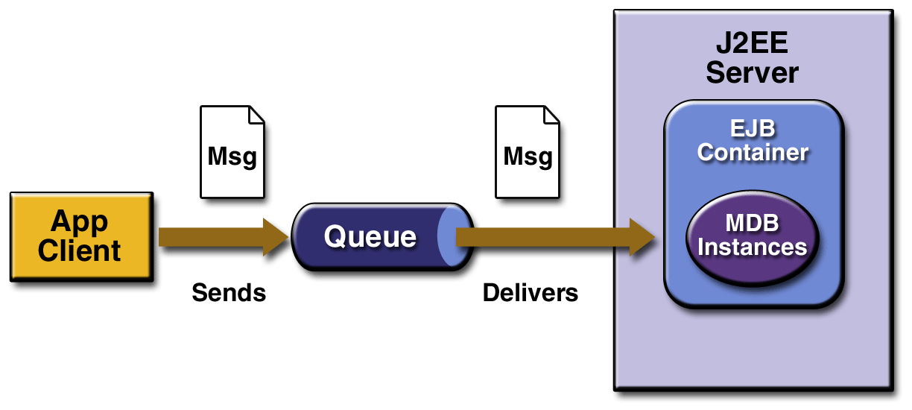
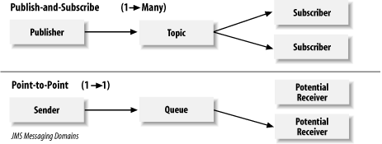
EJB 3.0 vs. EJB 2.0 – Message Driven Bean
SimpleMessageClient: A J2EE application client that sends several messages to a queue.
SimpleMessageEJB: A message-driven bean that asynchronously receives and processes the messages that are sent to the queue.

Slide 27
EJB 3.0 vs. EJB 2.0 – Message Driven Bean
public class ReservationProcessorBean implements javax.ejb.MessageDrivenBean,
javax.jms.MessageListener {
MessageDrivenContext ejbContext;
public void setMessageDrivenContext(MessageDrivenContext mdc) {
ejbContext = mdc;
}
public void ejbCreate() {}
public void onMessage(Message message) {
MapMessage reservationMsg = (MapMessage)message;
System.out.println ("The onMessage() is called");
}
public void ejbRemove() {
ejbContext = null;
}
}
@MessageDriven(activationConfig =
@ActivationConfigProperty(propertyName="destinationType", propertyValue="javax.jms.Queue")
@ActivationConfigProperty(propertyName="destination", propertyValue="queue/mdb") })
public class CalculatorBean implements MessageListener {
public void onMessage (Message msg) {
try {
TextMessage tmsg = (TextMessage) msg;
System.out.println ("The onMessage() is called");
} catch (Exception e) {
e.printStackTrace ();
}
}
EJB 2.0
EJB 3.0

Slide 28
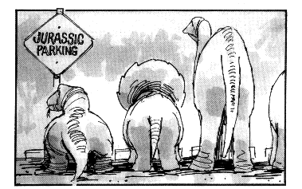
Security - Authorization

Slide 29

EJB 2.0 – Security - Authorization
<method-permission>
  <unchecked/>
  <method>
    <ejb-name>HelloBean</ejb-name>
    <method-name>*</method-name>
  </method>
</method-permission>
<method-permission>
  <exclude-list>
  <method>
    <ejb-name>HelloBean</ejb-name>
    <method-name>*</method-name>
  </method>
</method-permission>
<method-permission>
  <role-name>Boss</role-name>
  <method>
    <ejb-name>HelloBean</ejb-name>
    <method-name>sayHello</method-name>
  </method>
</method-permission>
Who cares ??. Every one can access
Kick you all ??
Only Boss can access

Slide 30


EJB 3.0 – Security - Authorization
EJB 3.0 provides annotations to specify security options. The following are the security
related annotations defined in EJB 3.0
  @SecurityRoles
  @MethodPermissions
  @Unchecked
  @Exclude
  @RunAs
@javax,ejb.SecurityRoles(roleNames={"admin", ”user"})
package oreilly.ejb30;
import javax.ejb.MethodPermissions;
import javax.ejb.StateLess;
import javax.ejb.Unchecked;
@Stateless
@MethodPermissions("admin")
public class LoginBean {
  public void updateProfile() {
  System.out.println ("Prifile Updated");
  }
  @MethodPermissions("GUEST")
  public void login() { //Statements }
  @Unchecked
  public void homePage() { //Statements }
}
Security using annotations

Slide 31

EJB 3.0 – Security - Authorization
<assembly-descriptor>
  <security-role-mapping name="GUEST">
    <user name="user"/>
  </security-role-mapping>
</assembly-descriptor>
@PermitAll
public class PayrollBean implements Payroll {
public double getAverage(){...}
@RolesAllowed({"HR_Manager", "HR_Admin"})
public double getSalary(int empId){...}
@RolesAllowed({"HR_Manager"})
public void setSalary(int empId, double salary){...}
@DenyAll
public void xxx(){...}
}

Slide 32
Transactions

Slide 33

EJB 3.0 vs. EJB 2.0 - Transactions
REQUIRED, REQUIRESNEW, MANDATORY, SUPPORTS, NEVER, NOT SUPPORTED
<container-transaction>
  <method>
  <ejb-name>HelloBean</ejb-name>
  <method-name>*</method-name>
  </method>
  <trans-attribute>Required</trans-attribute>
</container-transaction>
@Stateless
@PermitAll
@TransactionManagement(TransactionManagementType.CONTAINER)
@TransactionAttribute(REQUIRED)
public class HelloBean implements Hello {
public String sayHello(){
return "Hello EJB!";
}
}
EJB 2.0
ummm …
idea…
EJB 3.0

Slide 34
EJB 3.0 - Annotations

Slide 35
EJB 3.0 Annotations
Bean Level
  @Stateless, @Stateful, @MessageDriven and @Entity
Event callbacks
  @PostConstruct, @PreDestroy, @PrePassivate, @PostActivate
  = ejbCreate(), ejbRemove(), ejbPassivate(), ejbActivate() in EJB 2.0
Security
Transactions
  @TransactionAttribute
Dependency Injection Annotations
  @EJB, @Inject, @Resource
Data Sources
  @Stateless
  @Resource(name="jdbc/myDB", type=DataSource.class)
  public class PayrollBean implements Payroll {
  public void doSomething() {
  DataSource myDB = (DataSource) sc.lookup("jdbc/myDB");
  }
  }

Slide 36
EJB 3.0 Annotations
Mapping is still required for external resources
  EJB, DataSource, ConnectionFactory, Queue/Topic, URL...
  Mapping is not standard part, but vendor-specific part
Mapping in Vendor-specific DD.
Example:
  <res-ref>
  <ref-name>jdbc/myDB</ref-name>
  <export-name>oracleDatasource</export-name>
  </res-ref>
  <jdbc-connection-pool>
  <data-source-name>jdbc/myDB</data-source-name>
  <connection-properties>
  <user-name>SCOTT</user-name>
  <password>tiger</password>
  <url>jdbc:oracle:thin:@dbserver:1521:sid</url>
  <driver-class-name>oracle.jdbc.xa.client.OracleXADataSource
  </driver-class-name>
  </connection-properties>
  <jdbc-connection-pool>

Slide 37

Summary - EJB 3.0 Benefits
Simplified API
NO XML Descriptors
POJO Style
No JNDI
No Boilerplate code in EJB
Annotations
For Junior and mid level developers
Dependency Injection - IOC
Simplified Persistence API
Less number of classes
Java 1.5, 1.6 language features
O/R Mapping support
Rapid development
More work by container

Slide 38
Take a little Breath …..
JPA – Java Persistence API

Slide 39
Standardize Persistence API for
Java Platform
EJB 2.1 CMP
EJB3
Java
Persistence
API
Proprietary POJO
Persistence
JDO

Slide 40
About JPA
The Java Persistence API draws upon the best ideas from persistence technologies such as Hibernate, TopLink, and JDO.
Replacement of Entity bean
Similar to existing solution - Hibernate, Oracle TopLink
POJO based persistence model - Persistence API for operating on POJO entities
Merger of expertise from TopLink, Hibernate, JDO, EJB vendors and individuals
Created as part of EJB 3.0 within JSR 220
Released May 2006 as part of Java EE 5
Likely to progress separately from EJB in future
Integration with Java EE web and EJB containers
“Bootstrap API” can also be used in Java SE

Slide 41
Entity Manager
Client-visible artifact for operating on entities
  API for all the basic persistence operations
Can think of it as a proxy to a persistence
context
  May access multiple different persistence contexts throughout its lifetime

Slide 42
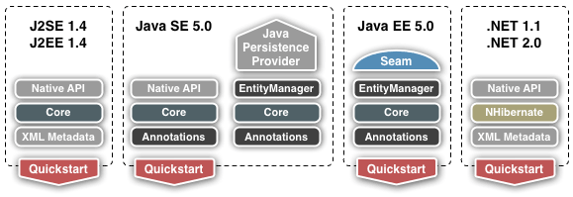
JPA Implementation in Hibernate

Slide 43
Entity Manager API
EntityManager API
  persist() - Insert the state of an entity into the db
  remove() - Delete the entity state from the db
  refresh() - Reload the entity state from the db
  merge() - Synchronize the state of detached entity with the pc
  find() - Execute a simple PK query - return null if not found
  createQuery() - Create query instance using dynamic JP QL
  createNamedQuery() - Create instance for a predefined query
  createNativeQuery() - Create instance for an SQL query
  contains() - Determine if entity is managed by pc
  flush() - Force synchronization of pc to database

Slide 44
Queries
Dynamic or statically defined (named queries)
Criteria using JP QL (extension of EJB QL)
Native SQL support (when required)
Named parameters bound at execution time
Pagination and ability to restrict size of result
Single/multiple-entity results, data projections
Bulk update and delete operation on an entity
Standard hooks for vendor-specific hints
Query instances are obtained from factory methods on EntityManager

Slide 45
Query API
Query API
  getResultList() – execute query returning multiple results
  getSingleResult() – execute query returning single result
  executeUpdate() – execute bulk update or delete
  setFirstResult() – set the first result to retrieve
  setMaxResults() – set the maximum number of retrieved results
  setParameter() – bind a value to a named or position parameter
  setHint() – apply a vendor-specific hint to the query
  setFlushMode() – apply a flush mode to the query

Slide 46
Dynamic Queries
Use createQuery() factory method at runtime and pass in the JP QL query string
  public List findAll(String entityName) {
    return entityManager.createQuery
    (“select e from ” + entityName + “ e”)
    .setMaxResults(100)
    .getResultList();
  }

Slide 47
Named Queries
Use createNamedQuery() factory method at runtime and pass in the query name
@NamedQuery(name=“Sale.findByCustId”,
query=“select s from Sale s
where s.customer.id = :custId
order by s.salesDate”)
public List findSalesByCustomer(Customer cust) {
  return entityManager.createNamedQuery (
    “Sale.findByCustId”) .
    setParameter(“custId”, cust.getId())
    .getResultList();
}

Slide 48
Object/Relational Mapping
Metadata may be annotations or XML (or both)
Annotations
  – Logical - object model (e.g. @OneToMany)
  – Physical - DB tables and columns (e.g. @Table)
XML
  – Can additionally specify scoped settings or defaults
Standard rules for default db table/column names
Direct mappings of fields/properties to columns
Common relationship mappings supported
  – @ManyToOne, @OneToOne - Single entity
  – @OneToMany, @ManyToMany - Collection of entities

Slide 49
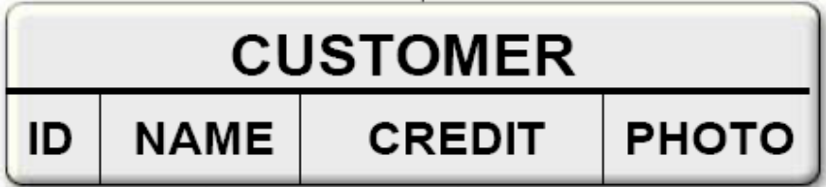
Simple Mappings
public class Customer {
  @Id
  Int id;
  String name;
  @Column(name=“CREDIT”)
  int c_rating;
  @Lob
  Image photo;
}

Slide 50
Simple Mappings
<entity class=“com.acme.Customer”>
  <attributes>
  <id name=“id”/>
  <basic name=“c_rating”>
  <column name=“CREDIT”/>
  </basic>
  <basic name=“photo”><lob/></basic>
  </attributes>
</entity>

Slide 51
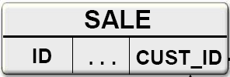

ManyToOne Mapping
@Entity
public class Sale {
  @Id
  int id;
  ...
  @ManyToOne
  Customer cust;
}

Slide 52

ManyToOne Mapping
  <entity class=“com.acme.Sale”>
    <attributes>
    <id name=“id”/>
    ...
    <many-to-one name=“cust”/>
    </attributes>
  </entity>
Many To One – M:1

Slide 53
Sample Example – Hibernate Mappings
<hibernate-mapping package="com.apollogrp.is3.notes">
<class name="NoteTaskDVO" table="NOTE_TASK" lazy="false">
<id column="ID" name="id" type="long">
<generator class="sequence">
<param name="sequence">s_note</param>
</generator>
</id>
<property name="taskId" column="TASK_ID" not-null="true" type="long"/>
<property name="noteId" column="NOTE_ID" not-null="true“ type="long"/>
</class>
</hibernate-mapping>
Insert the value into Reason REASON_CAMPUS_ID column while inserting an object
in parent table:
<many-to-one insert="true" update="false" name="reason" class="Reason" not-null="false">
<column name="REASON_CAMPUS_ID" />
</many-to-one>
Load the values while selecting the records from parent table:
<set name="relatedNotes" inverse="true" lazy="false" cascade="all“ table="note_task">
<key column="task_id"/>
<one-to-many class="com.apollogrp.is3.notes.NoteTaskDVO"/>
</set>
Sequence No’s

Slide 54
Persistence in Java SE
// Create EntityManagerFactory for a persistence unit called em1.
EntityManagerFactory emf = Persistence.createEntityManagerFactory("pu1");
// create EntityManager
EntityManager em = emf.createEntityManager();
// Get a transaction instance and start the transaction
EntityTransaction tx = em.getTransaction();
tx.begin();
// Create a new customer and persist it.
Customer c = new Customer();
c.setName("Joe Smith");
em.persist(c);
// Commit the transaction
tx.commit();
// run a Java Persistence query selecting a customer by name
String queryString = "SELECT c FROM Customer c WHERE c.name = :name";
Query query = em.createQuery(queryString);
query.setParameter("name", "Joe Smith");
List result = query.getResultList();
System.out.println("Java Persistence query " + queryString + " returns " + result);

Slide 55
Persistence in Java SE
<persistence xmlns="http://java.sun.com/xml/ns/persistence" version="1.0">
<persistence-unit name="pu1">
  <provider>oracle.toplink.essentials.ejb.cmp3.EntityManagerFactoryProvider</provider>
<!-- All persistence classes must be listed -->
<class>entity.Customer</class>
<class>entity.Order</class>
<class>entity.Item</class>
<properties>
<!-- Provider-specific connection properties -->
<property name="toplink.jdbc.driver" value="<database driver>"/>
<property name="toplink.jdbc.url" value="<database url>"/>
<property name="toplink.jdbc.user" value="<user>"/>
<property name="toplink.jdbc.password" value="<password>"/>
<!-- Provider-specific settings -->
<property name="toplink.logging.level" value="INFO"/>
</properties>
</persistence-unit>
</persistence>

Slide 56
JPA - Summary
Replacement of Entity bean
POJO-based persistence
model
Similar to existing solution – Hibernate,TopLink
Standard O/R mapping
Annotations and/or XML
SQL is generated for databases – only used for relational DB

Slide 57


Java EE & EJB 3.0
Application Name | Item Measured | J2EE 1.4 platform | Java EE 5 platform | Improvement
Adventure Builder | Number Of classes Lines Of Code | 67 3284 | 43 2777 | 36% fewer classes 15% fewer lines of code
RosterApp | Number Of classes Lines Of Code | 17 987 | 7 716 | 59% fewer classes 27% fewer lines of code
 | Number Of XML files Lines of XML Code | 9 792 | 2 26 | 78% fewer xml files 97% fewer lines of XML code

Slide 58
JBOSS 4.0.4 – Trailblazer
Examples: Demo on JBOSS 4.0.4 – Trailblazer

Slide 59
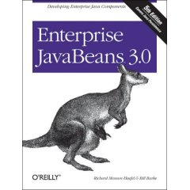
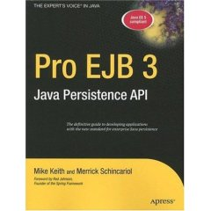
Resources
http://today.java.net/pub/a/today/2005/08/18/ejb3.html
http://www.oracle.com/technology/tech/java/oc4j/ejb3/howtos/howtoejb30security/doc/how-to-ejb30-security-ejb.html
http://www.caucho.com/resin-3.0/ejb3/tutorial/stateless/index.xtp - Inject example
http://www.caucho.com/resin-3.0/ejb3/bean-ann.xtp#@Resource - Resin examples
http://java.sun.com/developer/technicalArticles/J2EE/intro_ee5/#packaging
http://java.sun.com/j2se/1.5.0/docs/guide/language/annotations.html
Books:

Slide 60

Thank You

